Slide 1
IKON WAR
By: Ruchit,Nemil,Wishy,David

Slide 2
Project Overview:
The project is designed with various features like character build, different levels of the game, real world maps etc.
Purpose of this project is to promote the individual growth in all dimensions which includes educational, artistic, and other interpersonal skills.
The game is played on online server. The target audience for this game will be for teenagers with age range of 15- 30 years

Slide 3
Goals, Purpose and Motivation
The User Business or Background of the Project Effort
How will it benefit the client.
Goals of the Project
Universally accepted!
Measurement
Statistics, analysis, research work etc.

Slide 4
Scope
•This game requires winning games and increasing Matchmaking rank to team up with better players.
•Organizing a group of people and setup a virtual world is nearly impossible.
•The game will allow to join servers anytime from any location.
•Players can watch replays so they can learn from their previous games.

Slide 5
Events
•Create Account:- Allows a player to create and account with his unique ID that will be used in game play
•Select map:- Allows players to download a map from the map database.
•Find match:- Allows players to play in their own region and find players similar to their rank.
•Select Avatar:- Allows player to select and apply cosmetics linked to their account.

Slide 6
Product information and Maintenance:
User category for this product is Teen age or older.
No specific knowledge require for how to play game, just follow instruction if user is new.
If user find any bug they should know how to troubleshoot.
For live streaming demo, User can go on www.mixer.com.

Slide 7
Additional Application and More support
We need server for users can connect and save progress of users.
Internet connection does not require but If user want to play in party game (Multi player) than need internet connection.
No need any additional off-the-shell software.
There is no require to play in party game(Multi player) but recommended for getting better experience.

Slide 8
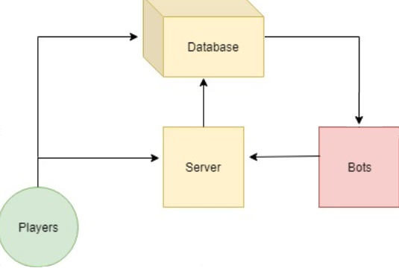
UML Diagram

Slide 9
Assumptions
Players will connect to the online hosted server for matchmaking with other players.
Players can create their own local server for offline play solo, or with bots.

